Slide 1
UE19CS390B – Capstone Project Phase – 2
Project Progress Review #1
Project Title : A Framework For Interactive ML Model visualizations in VR
Project ID : 92
Project Guide : Prof. Ananthanagu
Project Team : Manzood Naqvi PES2UG19CS223
Sohan Naidu PES2UG19CS398
P P Sujith PES2UG19CS272
Kevin Thomas PES2UG19CS184

Slide 2
Outline
Abstract
Scope
Capstone Project Phase – 1
Summary of work
System Architecture
Demo (Frontend + Backend)
Expected Deliverables
Individual Contributions
Technologies used
Timeline / Gantt chart

Slide 3
Abstract
Problem Statement:
Creating an extensible framework to build efficient and dynamic visualizations of Neural Networks in Virtual Reality.
Introduction:
Using a Human-In-The-Loop approach, being able to interact with models as they are training allows understand concepts such as hyperparameter tuning and their corresponding effects more intuitively.
In this project, we plan on building customizable ML visualizations for Neural Networks that can be interacted with at runtime. The system is to be made in a general way that allows for extensions in the kinds of neural networks that can be visualized later on.

Slide 4
Scope
Supporting ANNs and CNNs.
Currently, we plan on supporting any Neural Network that can be represented in an ONNX (Open Neural Network Exchange) format.
You will be able to touch individual neurons, play around with them, change weights, add/remove neurons and see the corresponding changes.

Slide 5
Summary of Work Done in Capstone Project Phase - 1
Constraining the problem statement
Literature Survey
Figured out which technologies to use
Decided on high-level data flow and sequence diagrams.
Suggestions:
Reduce scope
Explain stuff clearly in a concise, easy-to-understand manner

Slide 6
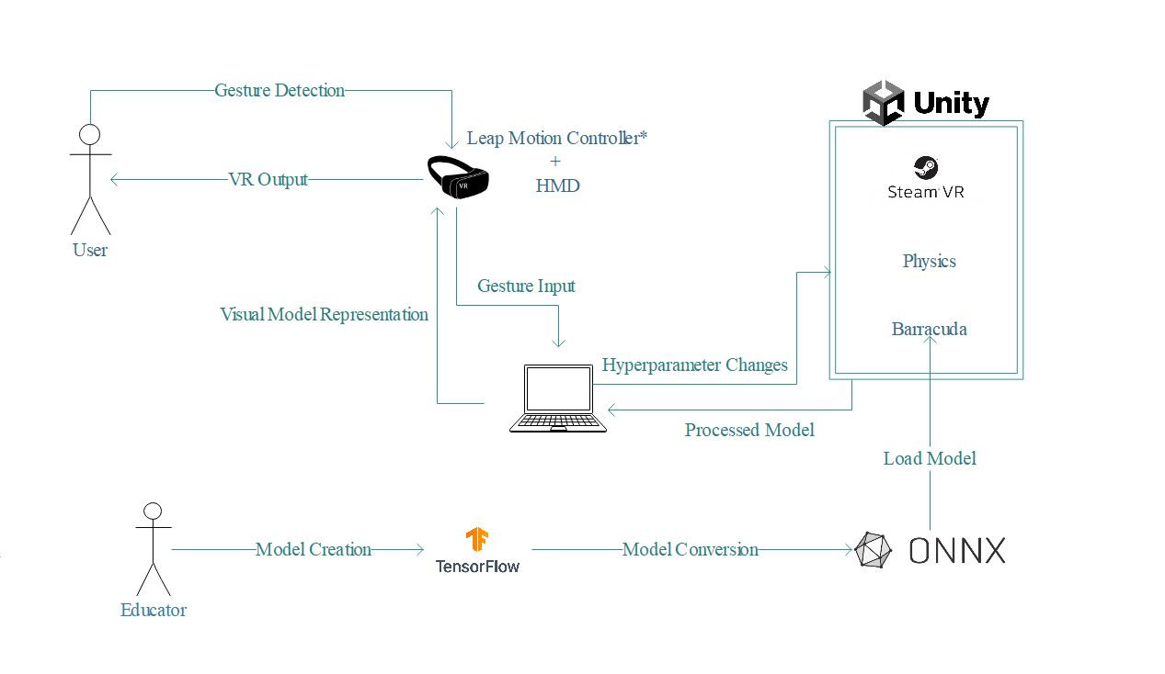
System Architecture

Slide 7
DEMO (frontend)

Slide 8
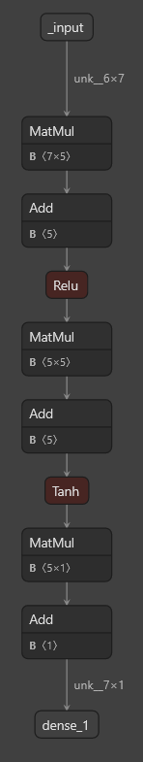
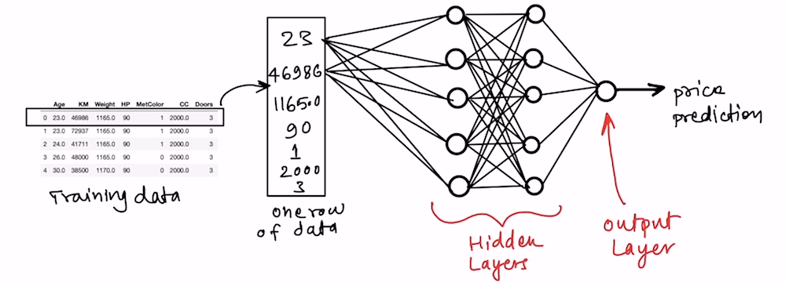
ONNX model
ONNX representation
Neural Network

Slide 9
Code Snippet for parameter change

Slide 10
Expected Deliverables
Tasks to be done:
Visualization of the training process
Running training process via a python script and using the results within Unity.
Physics Engine
Generalization of Neural Network parameter manipulation
Optimizations to handle scalability.

Slide 11
Individual Contributions
Name | Contribution
Manzood Ali Naqvi | Responsible for the current visualization of the neurons and connections within unity. Worked on parsing necessary information from the loaded ONNX model.
Sohan Naidu | Responsible for making changes to the loaded ONNX model in the backend. Also helped with the parsing process.
P P Sujith | Integrated Leap Motion Controller with SteamVR in Unity. Responsible for using the Ultraleap Interaction Engine to implement the current interactions.
Kevin Thomas | ???

Slide 12
Technologies Used
Unity
Ultraleap Tracking package
SteamVR package
Barracuda package
Trinus CBVR
C#, Python
Tensorflow/Keras, ONNX Graphsurgeon

Slide 13
Timeline (Gantt Chart)

Slide 14
Expected Deliverables
List of tasks/Modules to be elaborated in discussion with the guide.
For example, If your project consist of Data Preprocessing, the following should be explained,
Data Collection
Data Preparation
Data Input
Data Pre-processing
Data Visualization
Data Interpretation
Storage

Slide 15
Expected Deliverables
3. Tabulate the individual contribution of the team
members with the following,
Tasks/Modules assigned
Development (no. of lines of code & time spent)
4. List the SDK / API / Model / Jar/ DLL / Tools / Technologies used – Open-Source/ Licensed.
5. Testing for the module that is completed.
6. Demonstration and Result of modules completed.
7. Tabulate the timeline for all the tasks/modules.

Slide 16
References
[1] https://thinkingneuron.com/using-artificial-neural-networks-for-regression-in-python/

Slide 17
Thank You

